Slide 1
Cyclistic Case Study
By Parth Patel

Slide 2
Stakeholder Goal
Design marketing strategies aimed at converting casual riders into annual members. In order to do that, however, the team needs to better understand how annual members and casual riders differ, why casual riders would buy a membership, and how digital media could affect their marketing tactics.
Question to solve
How do annual members and casual riders use Cyclistic bikes differently?

Slide 3
Original Data Tables
Modified Data Tables (used in analysis)
Divvy Trips Q1 2019 Original Data
Divvy Trips Q1 2020 Original Data
Divvy Trips Q1 2019 Modified Data
Divvy Trips Q1 2020 Modified Data
R Code

Slide 4
Analytical Goal
How annual members and casual members use Cyclistics differently.
Identify areas the marketing team can focus on to covert casual members.

Slide 5
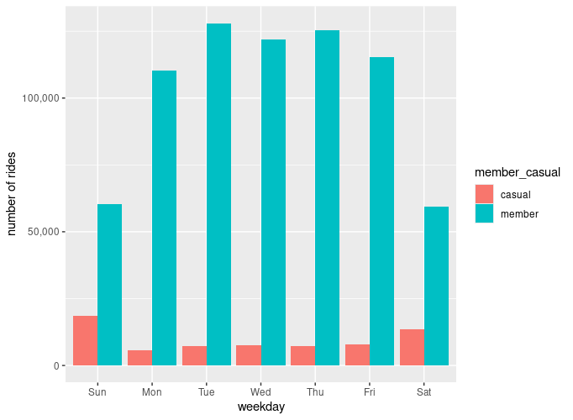
Number of rides by rider type
Members check out the bikes more often than causal riders.
Big drop in rides on Saturday and Sunday for members.
Big rise in rides on Saturday and Sunday for casual riders.

Slide 6
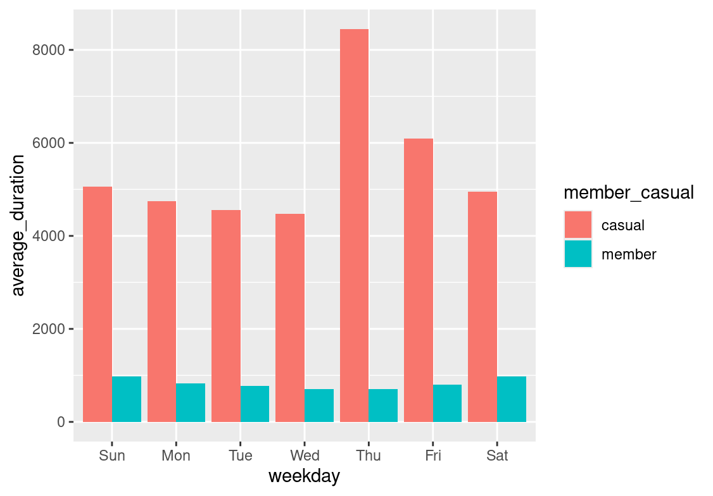
Duration of rides by rider type
Average rider duration:
Member = 795.25
Casual = 5372.78
Casual riders use the bike much longer than member riders.
The duration rises higher than average for members on Saturday and Sunday.
Thursday to Sunday is above average ride times for casual riders.

Slide 7
How annual members and casual members use Cyclistics differently.
Member users check out and use the bike more often than causal members.
Members check out bikes more on weekdays than weekends.
Casuals check out bikes more on weekends than weekdays.
Casual users ride for longer than members.
Members rider length are much shorter than casual rider length.

Slide 8
Identify areas the marketing team can focus on to covert casual members.
Recommendations:
Promote ways to use bikes for work commute for casual users.
This would help increase the number of bike riders for casuals members on weekdays.
It would also encourage casual users to members if their use frequency is increased.

Slide 9
Conclusion
The casual users seem to use their bike rides for longer trips with a casual purpose.
The members seem to use their bikes for a more specific purpose, mainly on weekdays, for probably work commute.
The marketing team should focus on promoting bikes for commuting purpose to covert the casual users into members.

